Slide 1

JamCoders: Week 1
Lecture 1A:
Intro, CS Demo
Arithmetic
Expressions
Variables

Slide 2
Intro & Logistics

Slide 3


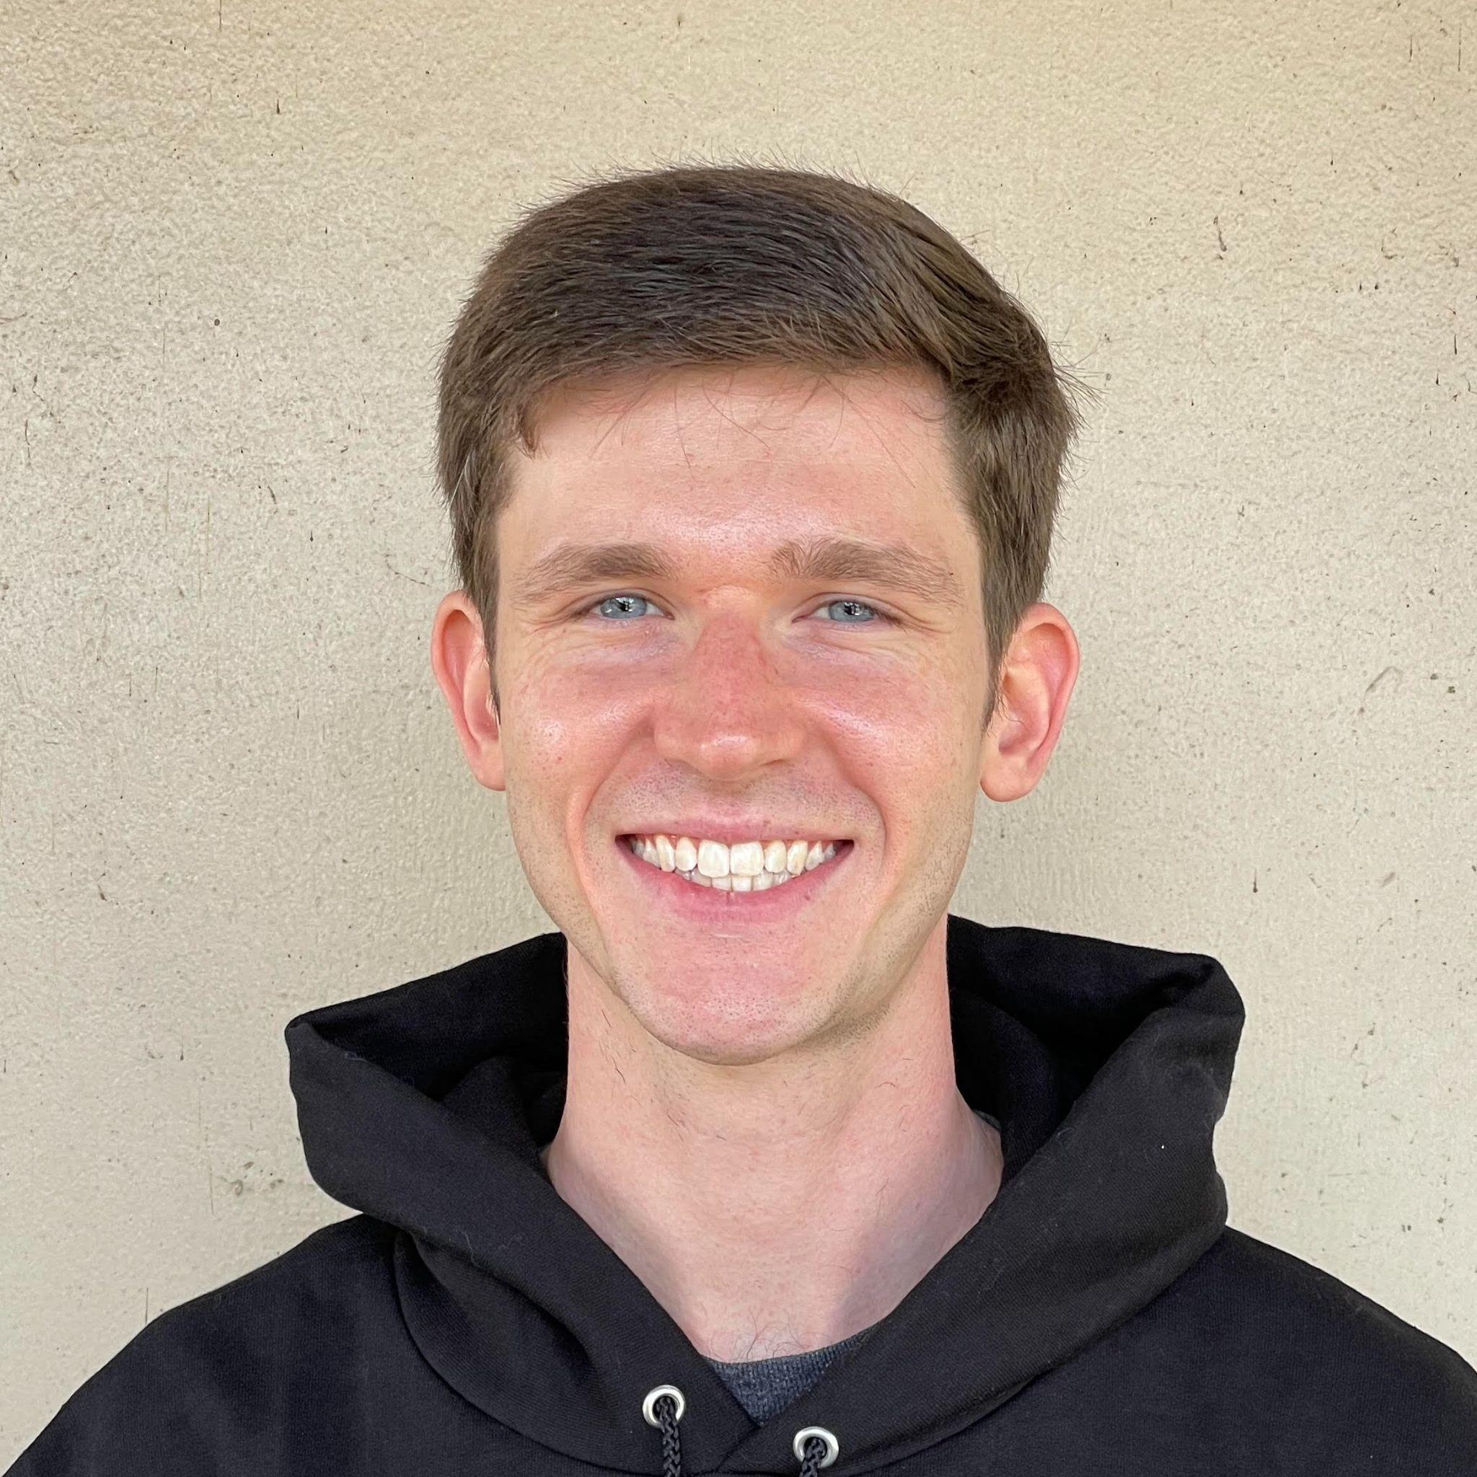
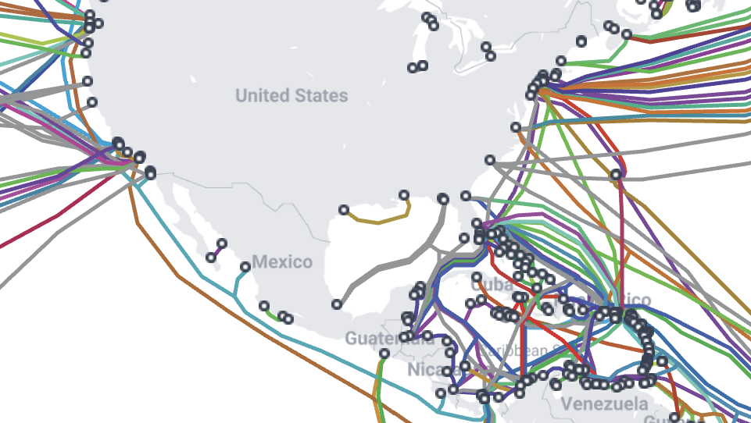
Who am I?
My name is Alex Krentsel.
Senior Researcher at Google, designing internet architecture.
Subsea cable map
Notes:
Out of curiosity - quick show of hands, how many people here watch YouTube? I’m looking forward to learning about all of you this week.

Slide 4
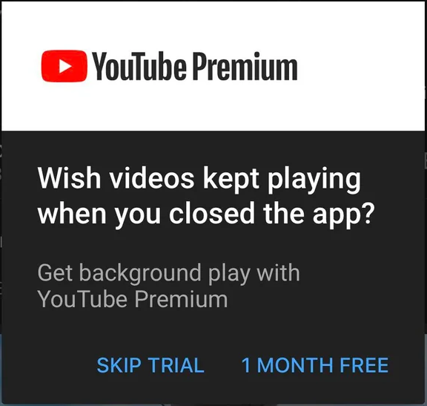

Who am I?
My name is Alex Krentsel.
Senior Researcher at Google, designing internet architecture.
Computer Science PhD Student at UC Berkeley
Previously:
Software Engineer at YouTube
CS Lecturer at Howard University
Live in California. In my free time, I like to play violin, hike, and cook.
Notes:
Out of curiosity - quick show of hands, how many people here watch YouTube? I’m looking forward to learning about all of you this week.

Slide 5
Who are you?
Notes:
3rd-5th form

Slide 6
What is this course?

Slide 7
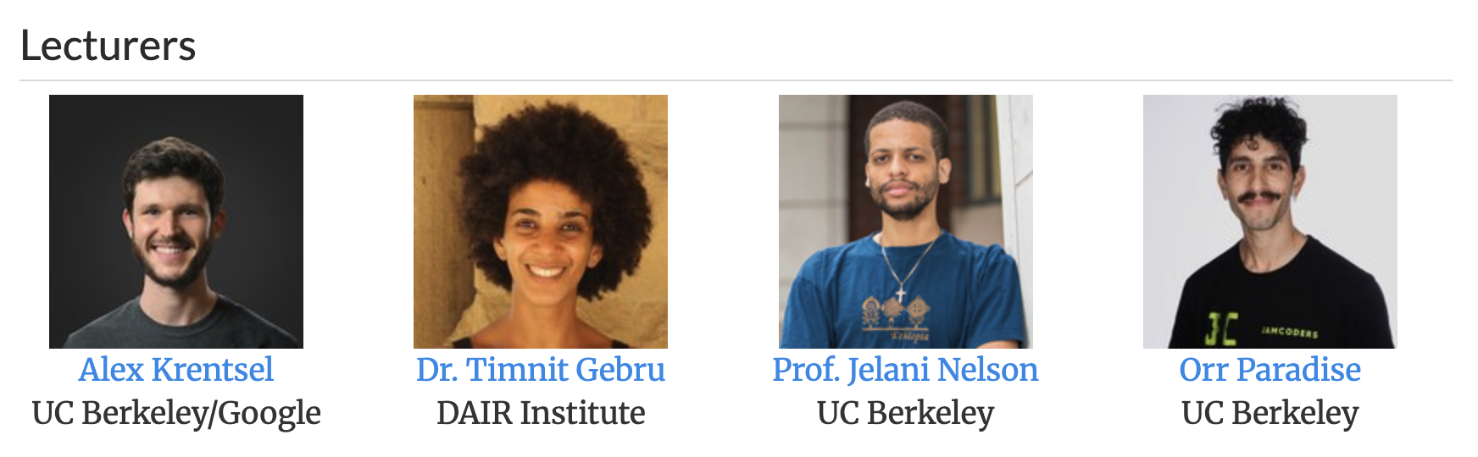
Course Overview
Goal: build a core foundation of computational thinking through studying data structures and algorithms.
4 weeks of instruction:
Week 1: Core Python Programming Concepts
Week 2: Advanced Programming
Week 3: Algorithms
Week 4: Data Structures

Slide 8
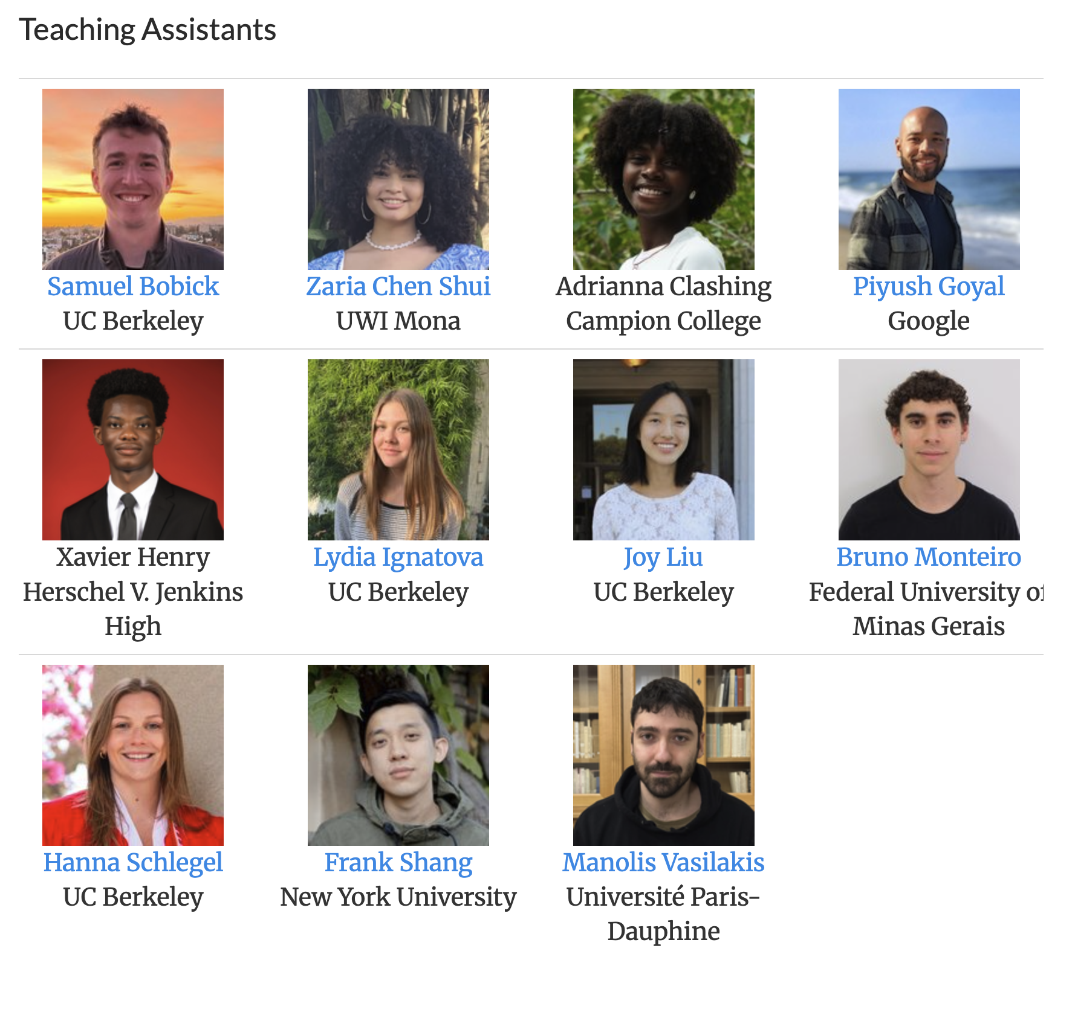
Who?
Fantastic teaching team
Mix of current students (undergrad, graduate), and industry workers
ask them questions
Notes:
You’re in really good hands here.

Slide 9
Day Structure
Morning/Afternoon blocks, made up of…
Lecture: big room, one lecturer teaching at the front, demonstrating on the computer, no computers
Lab: smaller room, each student working on their own computer to solve problems, TAs around to help
TIME | SCHEDULE
9:00-10:00 | Morning Lecture A
10:00-10:15 | Break
10:15-12:15 | Morning Lab A
12:15-1:45 | Lunch
1:45-2:45 | Afternoon Lecture B
2:45-3:00 | Break
3:00-5:00 | Afternoon Lab B

Slide 10

Week 1 Overview
Learning Objectives for Week 1:
Learning the “language of computers”
How to express logic in code to solve problems
“Computational thinking”: Code blocks as units of work
By the end of this week, you’ll know…
Core: variables, expressions, operators, conditionals, print, input
Types: booleans, ints, floats, strings, lists; casting
Loops: for, while, range, nesting
Functions: defining, calling, args. vs params, scope, return
Misc: mutability, style, errors

Slide 11
Lecture Structure
Mix of slides and Jupyter Notebook
Questions throughout
Interactive!
Let’s begin!

Slide 12
Lecture Goals
By the end of lecture 1A, you will know…
Course logistics (just finished)
Fun: what you can do with CS in 2 weeks
What is programming and where do we do it?
Basic building blocks of code (30min)
Math Operators
Errors
Variables
Printing
Types

Slide 13
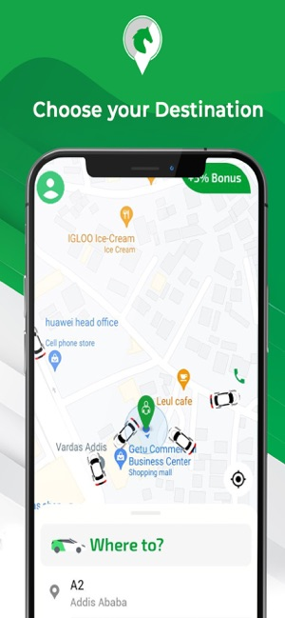
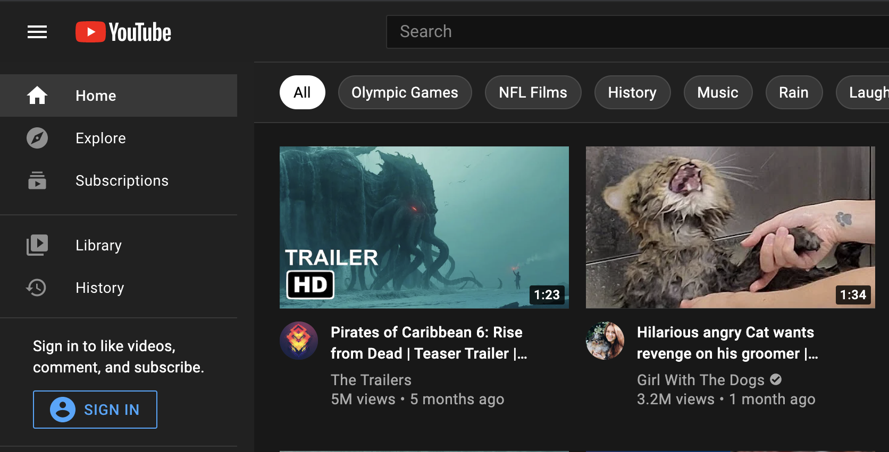
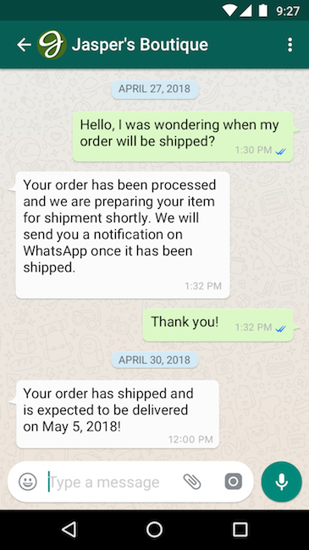
Why Study Computer Science?
Modern daily life power by CS.
Notes:
Especially during COVID, daily life is powered by CS

Slide 14
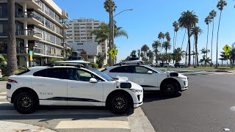
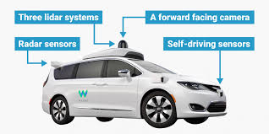
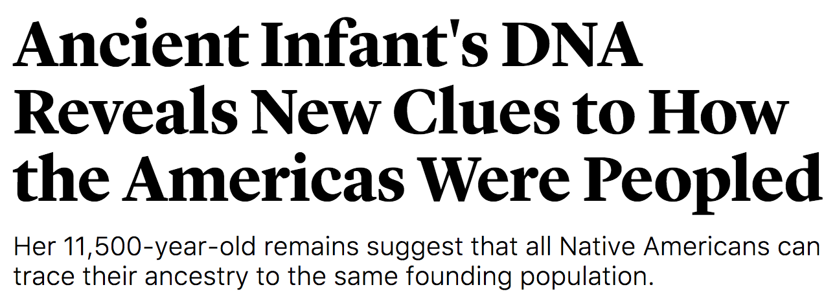

Why Study Computer Science?
Major driver of progress of our civilization.
Notes:
http://www.businessinsider.com/how-does-googles-waymo-self-driving-car-work-graphic-2017-1

Slide 15
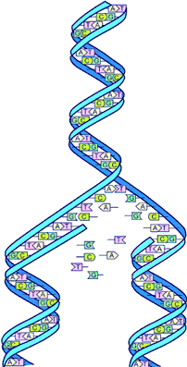
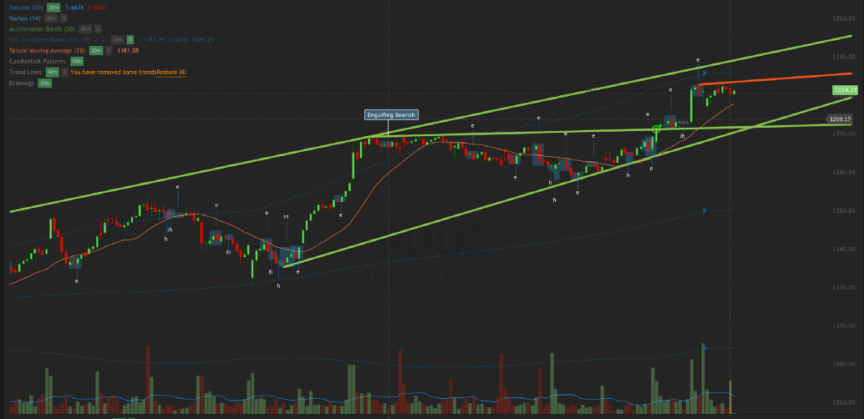
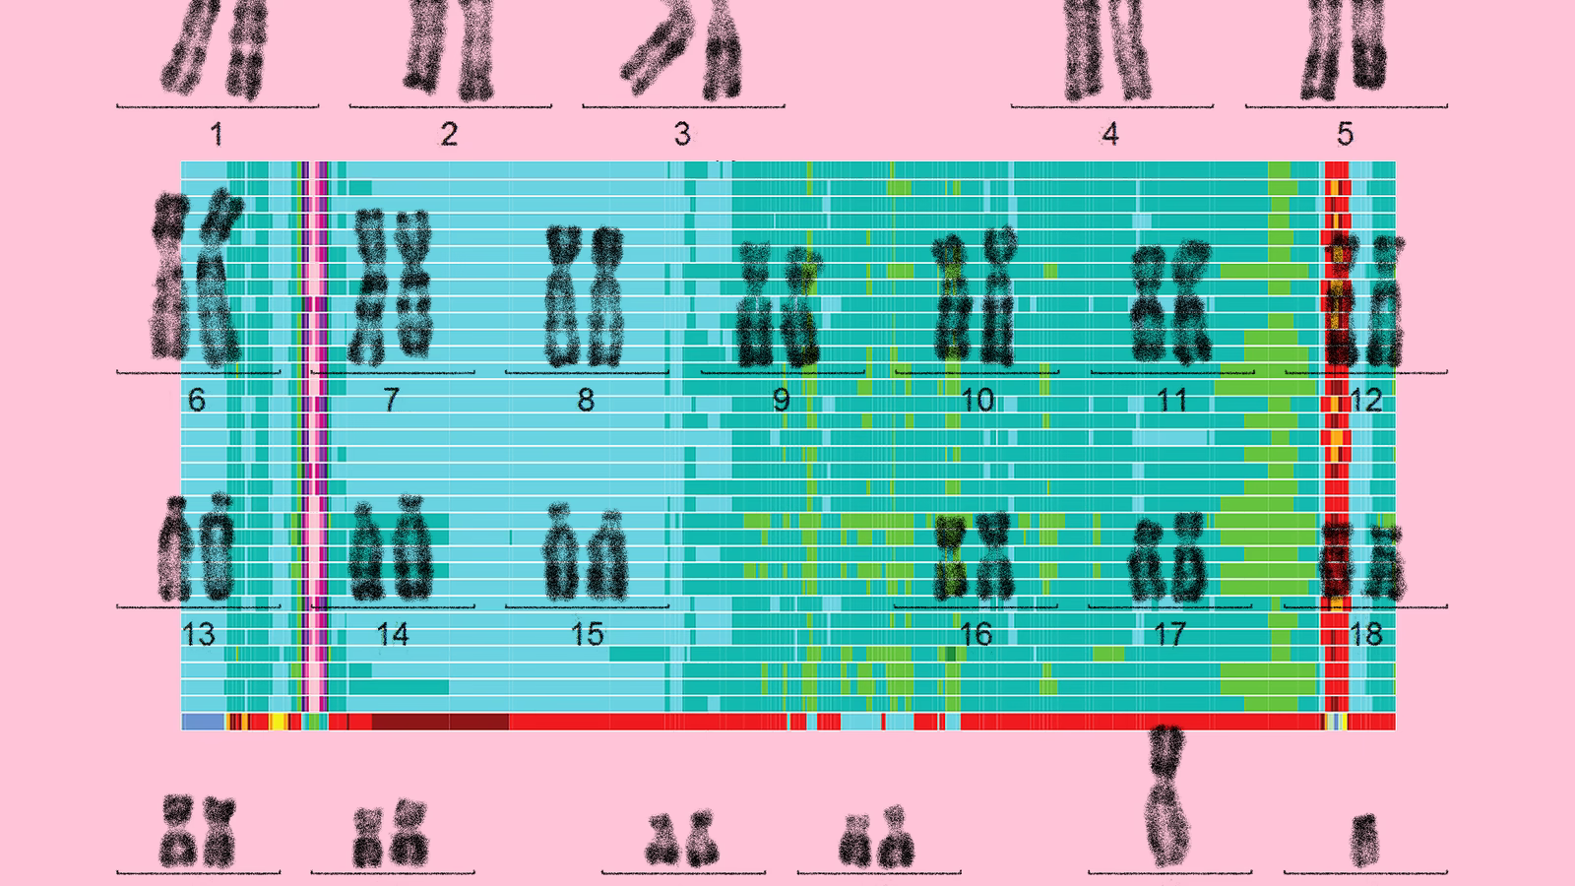
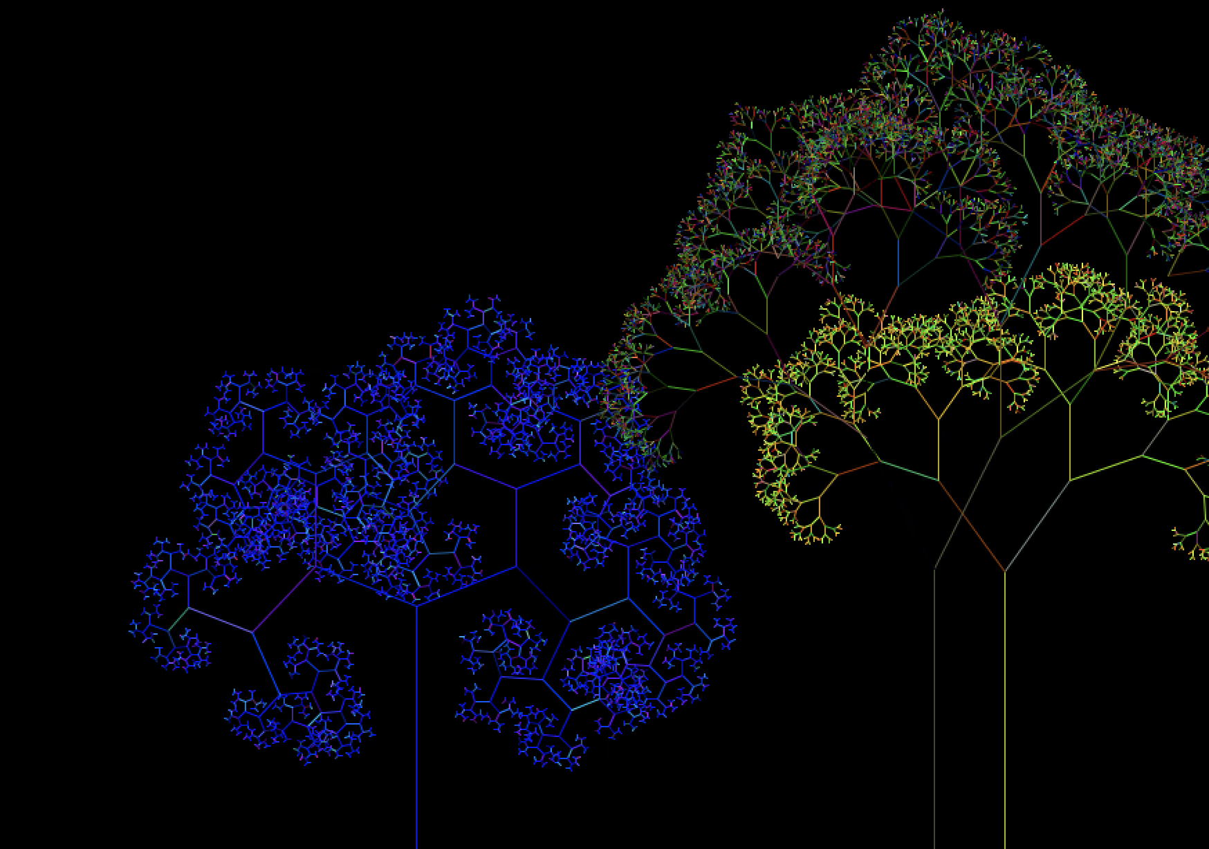
Why Study Computer Science?
Not just by traditional Software Engineering...
Notes:
Mapping the human genome (algorithms to match parts up), Quant stock trading algorithms, art

Slide 16
Why Study Computer Science?
Many reasons beyond just wanting to make websites and apps!
It’s also just fun :)

Slide 17
Programming?

Slide 18
What is programming?
“Programming” is designing and writing code to accomplish some task.
Smaller Tasks
Compound Interest calculator
Show an image on a screen
Make a robot move its arm to the right
Bigger Tasks
Browse videos on YouTube (build the YouTube app)
Build a website for your class (like jamcoders.org.jm)
Find the optimal route from Kingston airport to UWI

Slide 19
Running Code
What happens when you run code?
num_people = 5
Notes:
So now that we know this, how does running code work?

Slide 20
Running Code
What happens when you run code?
Compiler
num_people = 5
Notes:
Code you write gets given to the “compiler”

Slide 21
Running Code
What happens when you run code?
Compiler
10110110 00111001 10011010 11111001 11000101 00000001
num_people = 5

Slide 22
Running Code
What happens when you run code?
Compiler
10110110 00111001 10011010 11111001 11000101 00000001
num_people = 5
Programming Language (Python)
Machine Language (Binary)

Slide 23

Running Code
What happens when you run code?
Compiler
10110110 00111001 10011010 11111001 11000101 00000001
num_people = 5
Programming Language (Python)
Machine Language (Binary)
10110110 00111001 10011010 11111001 11000101 00000001

Slide 24
Running Code
What happens when you run code?
Compiler
10110110 00111001 10011010 11111001 11000101 00000001
num_people = 5
Programming Language (Python)
Machine Language (Binary)
Output of the program:
Calculate something
Show an image
Make a sound
etc.
10110110 00111001 10011010 11111001 11000101 00000001

Slide 25
Languages
There are many different programming languages…
Python
Scratch
Java
C/C++
Javascript
Go
R
Swift

Slide 26
Languages
There are many different programming languages…
Python
Scratch
Java
C/C++
Javascript
Go
R
Swift
All of them get translated to the same “binary” language that the hardware understands.
Python Compiler
num_people = 5
Programming Language (Python)
Java Compiler
10110110 00111001 10011010 11111001 11000101 00000001
int num_people = 5
Programming Language (Java)
Machine Language (Binary)
C++ Compiler
uint32_t num_people = 5
Programming Language (C++)

Slide 27
Languages
There are many different programming languages…
Python
Scratch
Java
C/C++
Javascript
Go
R
Swift
All of them get translated to the same “binary” language that the hardware understands.
Language we will learn in this class
Python Compiler
num_people = 5
Programming Language (Python)
Java Compiler
10110110 00111001 10011010 11111001 11000101 00000001
int num_people = 5
Programming Language (Java)
Machine Language (Binary)
C++ Compiler
uint32_t num_people = 5
Programming Language (C++)

Slide 28
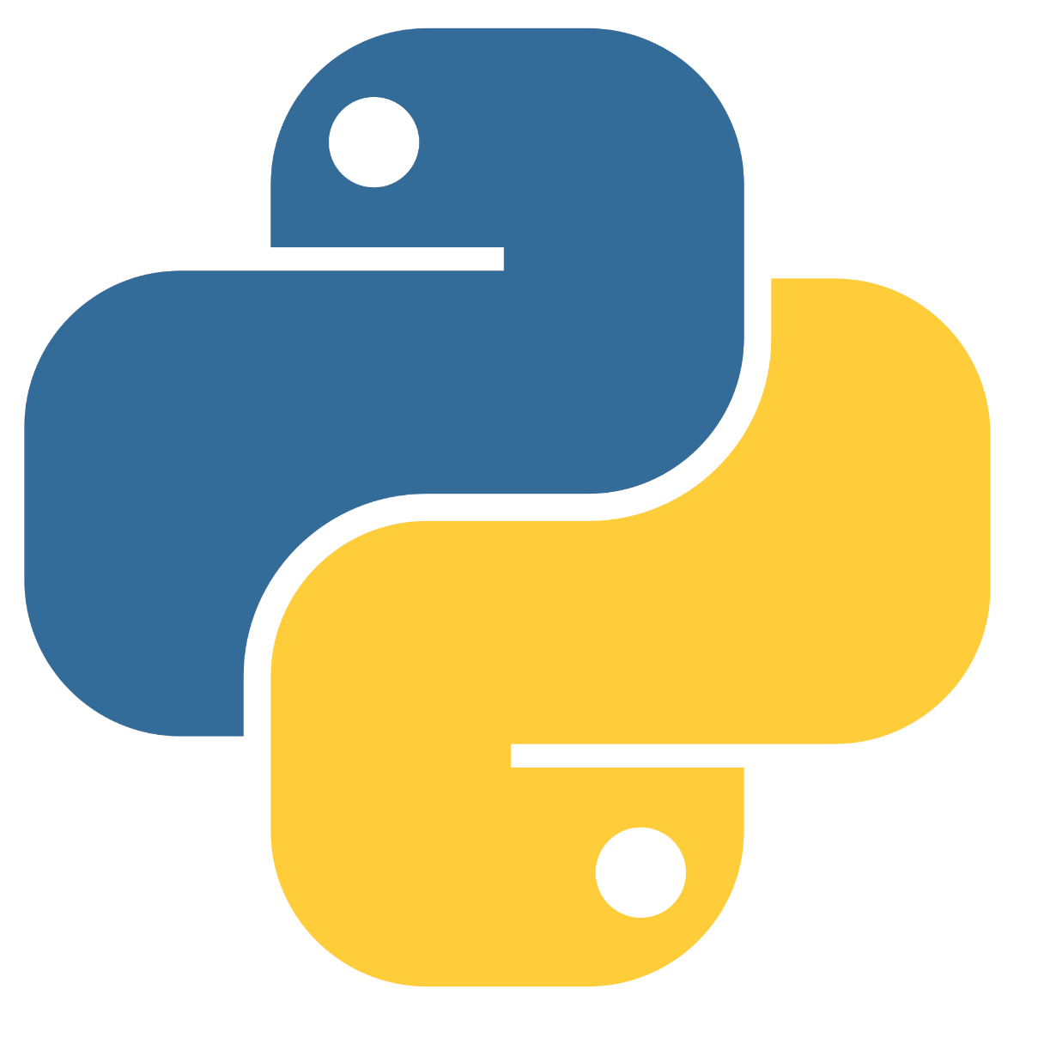

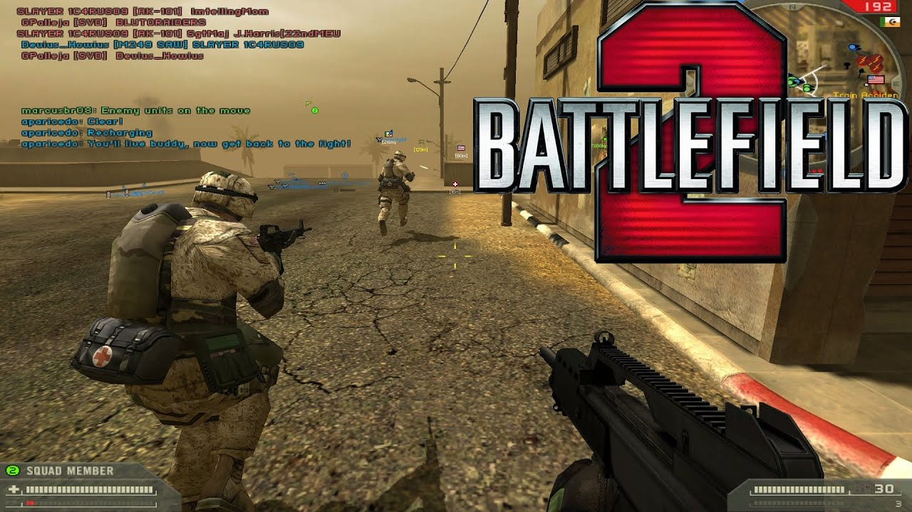

Why Learn Python?
Perfect language to start coding in
Easy to read
Very little “syntax”
syntax: the rules of grammar in a programming language
Used extensively in the real world

Slide 29
Programming Environment
We will be coding in a “Notebook” or “Colab”...
Let’s jump to it

Slide 30
Expressions

Slide 31
Expressions
Expressions are combinations of operators and values evaluating to a single value.
Evaluates to 6.
Operands
2 + 4
Operator

Slide 32
Expressions
The operands in an expression can themselves be expressions. Expressions are always evaluated operand-first.
Python will simplify any expression, no matter how complicated, down until it gets to a single value!
17 + (3 * 11)
17 + (33)
50

Slide 33
Arithmetic Operators
The same operators that you’re used to in math work in Python.
Addition (+)
Subtraction (-)
Multiplication (*)
Division (/)
Exponentiation (**)
(this is the same as 2⁶)
sum = 5 + 6
power = 2 ** 6
diff = 12 - 5
product = 8 * 4
quot = 12 / 5

Slide 34
Arithmetic Operators
If applying multiple operators, use parentheses to control the order they get evaluated, just like in math:
7 + ((20 / 4) ** 2)
7 + ((20 / 4) ** 2)
7 + (5.0 ** 2)
7 + 25.0
32.0

Slide 35
Handy New Arithmetic Operators
Floor division: // divides 2 numbers and rounds down to the nearest int.
x // y answers the questions “How many times does Y completely fit into X?”
Examples:
10 // 2 == 5
11 // 2 == 5
175 // 4 == 43

Slide 36
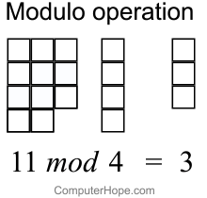
Handy New Arithmetic Operators
Modulo: % computes remainder after division
a % b
Examples:
11 % 5 == 1
120 % 100 == 20
1 % 5 == 1
24 % 2 == 0

Slide 37
Variables

Slide 38
Think back to your algebra class...
a = 5
b = 6
c = a + b
What’s the value of c?
How did you know?
Notes:
a and b are letters, so how do you add them together? You don’t! You are adding together the values that those letters are holding.

Slide 39
Python Variables
Python has the same concept.
A variable is a storage location filled with a value and associated with an identifier
num_apples = 5

Slide 40
Two New Variable Words...
“Assign” a variable
“Reference” a variable

Slide 41
Assign and Reference
Assigning a variable means storing a value in memory with a given name.
In variable assignment, the variable name is always on the left side of the equals sign:
x = 7 y = x + 2

Slide 42
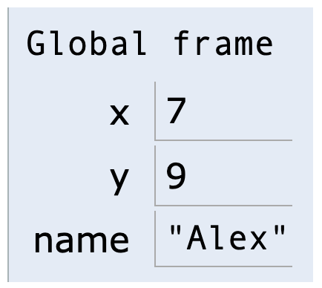
Assign and Reference
Assigning a variable means storing a value in memory with a given name.
In variable assignment, the variable name is always on the left side of the equals sign:
x = 7 y = x + 2 name = "Alex"

Slide 43
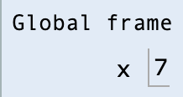
“Reference”
Referencing a variable is how you read the value from memory.
x = 7 print(x)

Slide 44
Assign and Reference
You can reassign a variable...give it a new value.
x = 7 print(x) x = 9 print(x)

Slide 45
Assign and Reference
You can reassign a variable...give it a new value.
x = 7 print(x) x = 9 print(x)

Slide 46
Assign and Reference
You can reassign a variable...give it a new value.
x = 7 print(x) x = 9 print(x)

Slide 47
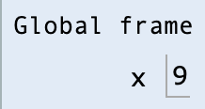
Assign and Reference
You can reassign a variable...give it a new value.
x = 7 print(x) x = 9 print(x)

Slide 48
Assign and Reference
You can reassign a variable...give it a new value.
x = 7 print(x) x = 9 print(x)

Slide 49
Assign and Reference
Bonus word: “declare” (you won’t see this one often in this class)
The very first time you assign a variable a value is called “declaring” the value.
x = 7 print(x) x = 9 print(x)

Slide 50
Variable Names in Python
Must be made up of letters, digits (0-9) or the underscore character _ .
May not start with a digit.
May not be a “reserved word”

Slide 51

Variable Names in Python
Must be made up of letters, digits (0-9) or the underscore character _ .
May not start with a digit.
May not be a “reserved word”
x Alex alex2 first_name _first_name BLUE_BISON

Slide 52

Variable Names in Python
Must be made up of letters, digits (0-9) or the underscore character _ .
May not start with a digit.
May not be a “reserved word”
x Alex alex2 first_name _first_name BLUE_BISON
alex@! 2472ab 1st_street for

Slide 53
How Python Runs

Slide 54
What Would Python Print? (WWPP)
Python runs and executes code line-by-line.
a = 5 b = 6 c = a + b b = 10 print(c)

Slide 55
What Would Python Print? (WWPP)
Python runs and executes code line-by-line.
a | b | c
5
5 | 6
5 | 6 | 11
5 | 10 | 11
5 | 10 | 11
a = 5 b = 6 c = a + b b = 10 print(c)

Slide 56
Extra Slides

Slide 57
A bit of learning theory...

Slide 58
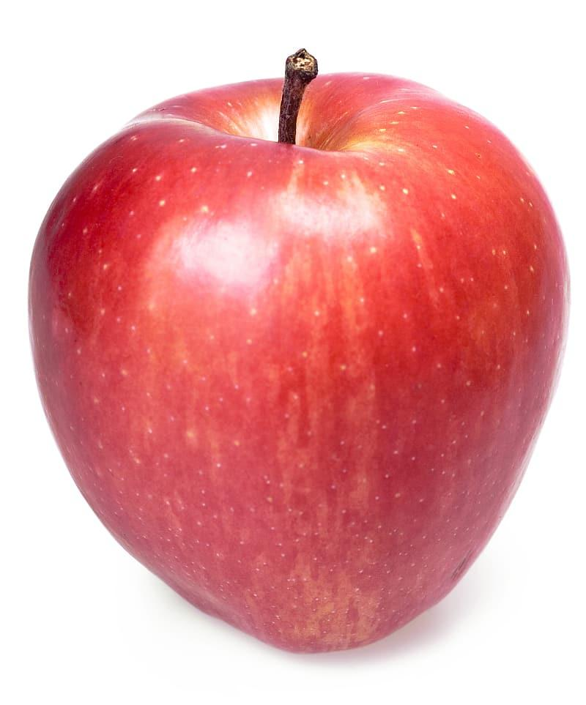

Concepts vs Syntax
Apple!
Manzana!

Slide 59
Concepts vs Syntax
Concept
Apple!
Manzana!

Slide 60
Concepts vs Syntax
Concept
Apple!
Manzana!
Syntax

Slide 61
Types of Learning in this Class
Type 1
Concept you already know
New “syntax”
Apple
Manzana

Slide 62
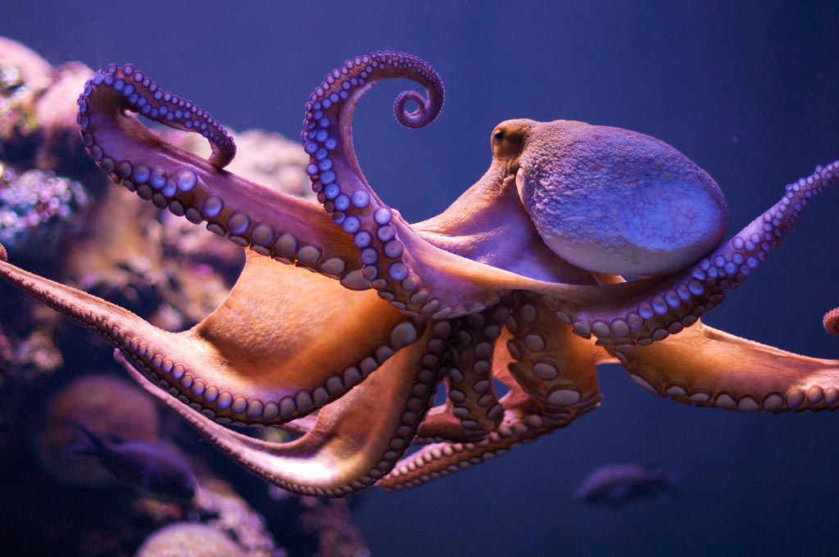
Types of Learning in this Class
Type 1
Concept you already know
New “syntax”
Type 2
New Concept and New “syntax”
Apple
Manzana
Cephalopod
Cefalópodo

Slide 63
Types of Learning in this Class
Type 1
Concept you already know
New “syntax”
Examples
Math operators (+, -, *, /)
Variables (y = mx + b)
Lists
Type 2
New Concept and New “syntax”

Slide 64
Types of Learning in this Class
Type 1
Concept you already know
New “syntax”
Examples
Math operators (+, -, *, /)
Variables (y = mx + b)
Lists
Type 2
New Concept and New “syntax”
Examples
Functions
Recursion
Control Flow

Slide 65
Types of Learning in this Class
Keep this difference in mind as you’re learning.
Make sure you understand the concept on its own, and how to apply it (the “syntax”) in Python.

Slide 66


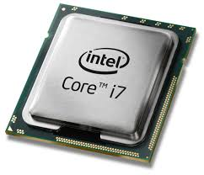


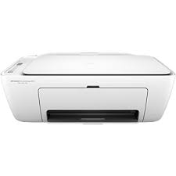
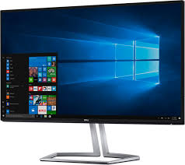
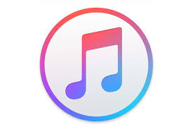

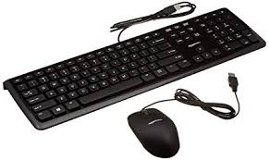
Software
Hardware

Slide 67

Software
Hardware
while cond != True:
instr = gen_inst()
cond = eval(instr)
return instr
1100 1001
1101 0111
0010 1101
1001 1001
Understands Human instructions
Understands “Binary Code” Instructions
Compiler
Notes:
But to understand what the software that we write is doing, we need to know *some* stuff about the hardware.

Slide 68
Software
Hardware
This Class
while cond != True:
instr = gen_inst()
cond = eval(instr)
return instr
1100 1001
1101 0111
0010 1101
1001 1001
Understands Human instructions
Understands “Binary Code” Instructions
Compiler

Slide 69
Software
Hardware
This Class
Python
while cond != True:
instr = gen_inst()
cond = eval(instr)
return instr
1100 1001
1101 0111
0010 1101
1001 1001
Understands Human instructions
Understands “Binary Code” Instructions
Compiler
Notes:
This is Python, the language we’ll be learning in this course.
But to understand what the software that we write is doing, we need to know *some* stuff about the hardware.

